Slide 1

现代通信光电子学
第11章：群速度色散
电子科技大学信息与通信工程学院
2018-2019秋季学期

Slide 2
Group-Velocity Dispersion
GVD effects in fiber
Dispersion-Induced Pulse Broadening
Third-Order Dispersion
Dispersion Management

Slide 3
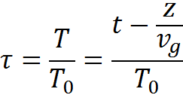

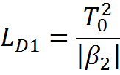
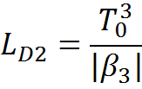

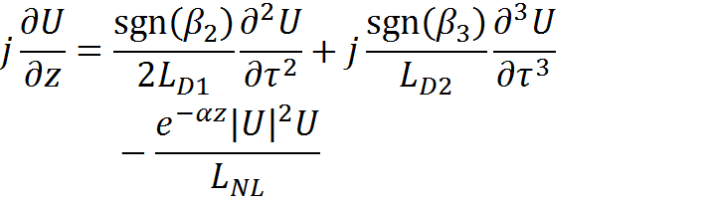
GVD effects in fiber
The normalized time scale and the normalized amplitude
The dispersion length and the nonlinear length
The normalized amplitude is found to satisfy

Slide 4
GVD effects in fiber
Depending on the relative magnitudes of L, L_{D}, and L_{NL}, the propagation behavior can be classiﬁed in the following four categories.
L<<L_{D} & L<< L_{NL}: pulse undistorted
L<<L_{NL} & L ~L_{D} : dispersion-dominant regime
L<<L_{D} & L ~ L_{NL}: nonlinearity-dominant regime
L ~ L_{D} & L ~ L_{NL} : the interplay of the GVD and SPM effects can lead to a qualitatively different behavior compared with that expected from GVD or SPM alone.

Slide 5
Group-Velocity Dispersion
GVD effects in fiber
Dispersion-Induced Pulse Broadening
High-Order Dispersion
Dispersion Management

Slide 6

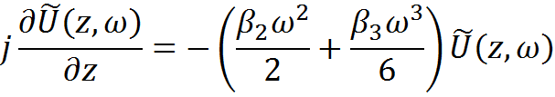
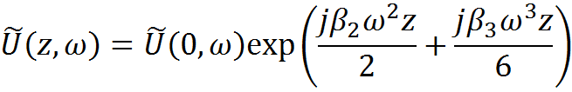
GVD-Induced Pulse Broadening
In the dispersion-dominant regime, the normalized amplitude satisfies
In the frequency domain it is an ordinary differential equation
The solution is
GVD changes the phase of each spectral component of the pulse by an amount that depends on both the frequency and the propagated distance.

Slide 7
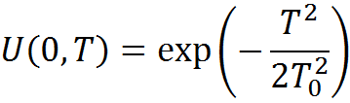

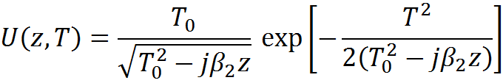
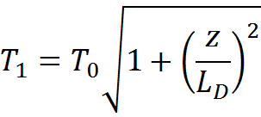
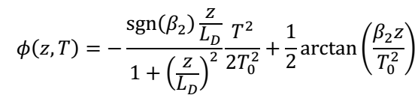
GVD-Induced Pulse Broadening
Gaussian pulse with the half-width (at 1/e intensity point) T₀
The full width at half maximum
The amplitude at any point along the ﬁber is given by
Thus, a Gaussian pulse maintains its shape on propagation but its width increases, and the transmitted pulse becomes chirped.

Slide 8
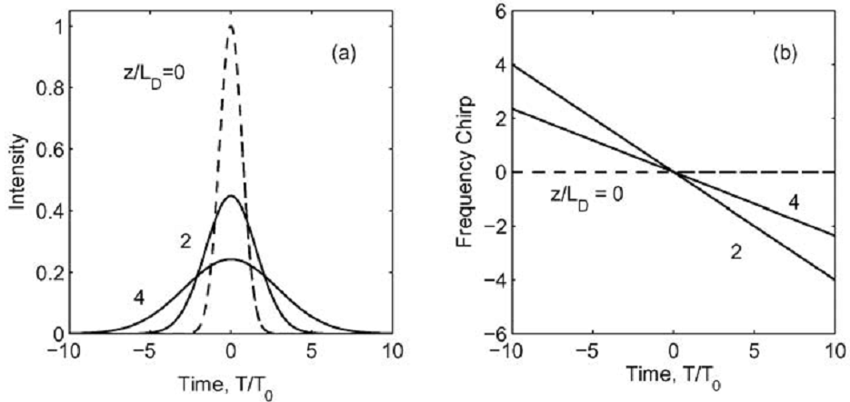

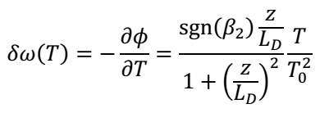
GVD-Induced Pulse Broadening
The frequency changes linearly across the pulse

Slide 9
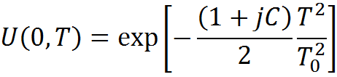
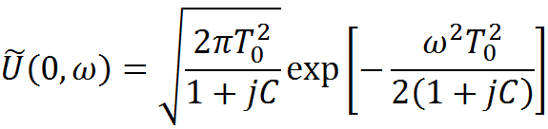
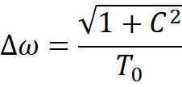

GVD-Induced Pulse Broadening
In the case of linearly chirped Gaussian pulses, the incident ﬁeld can be written as
C>0, up-chirp
C<0, down-chirp
In the frequency domain
The spectral half-width is given by
For an unchirped Gaussian pulse, we have

Slide 10
Group-Velocity Dispersion
GVD effects in fiber
Dispersion-Induced Pulse Broadening
Third-Order Dispersion
Dispersion Management

Slide 11

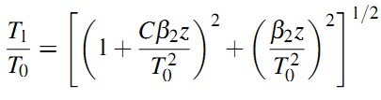

GVD-Induced Pulse Broadening
The transmitted ﬁeld
Thus, even a chirped Gaussian pulse maintains its Gaussian shape on propagation. The width after propagating a distance is related to the initial width by the relation
The chirp parameter becomes

Slide 12
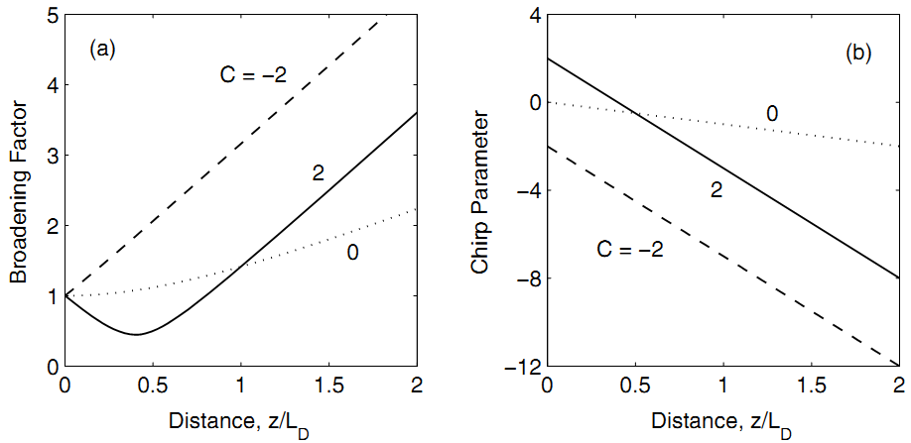


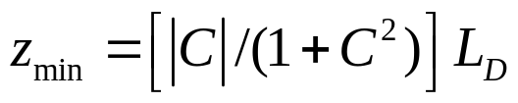
GVD-Induced Pulse Broadening
In the case of anomalous dispersion, chirped pulses may broaden or compress depending on whether β₂ and C have the same or opposite signs.

Slide 13

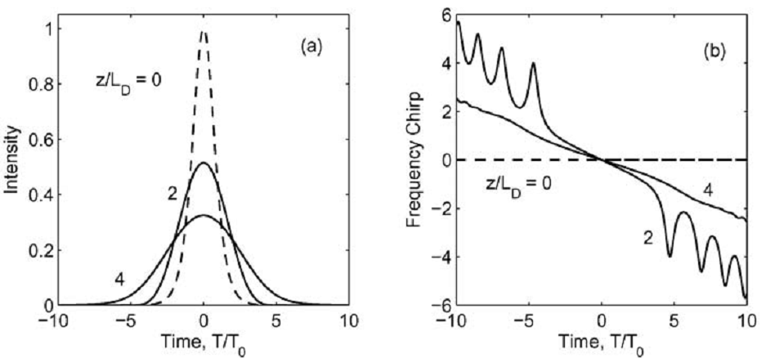

GVD-Induced Pulse Broadening
The hyperbolic secant pulse shape is of particular interest in the context of optical solitons and pulses emitted from some mode-locked lasers.

Slide 14

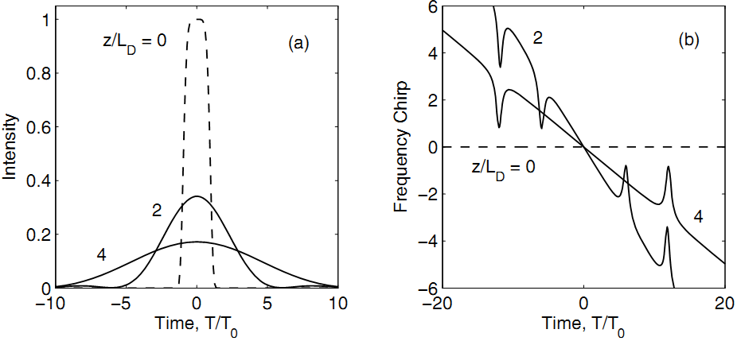
GVD-Induced Pulse Broadening
In general, a pulse with steeper leading and trailing edges broadens more rapidly with propagation because such a pulse has a wider spectrum to start with. A super-Gaussian shape can be used to model the effects of steep edges on dispersion-induced pulse broadening.
The super-Gaussian pulse not only broadens at a faster rate but is also distorted in shape; the chirp proﬁle is also far from being linear.

Slide 15


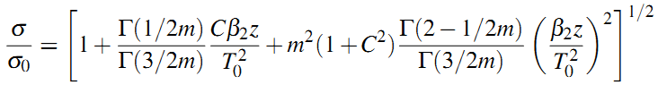
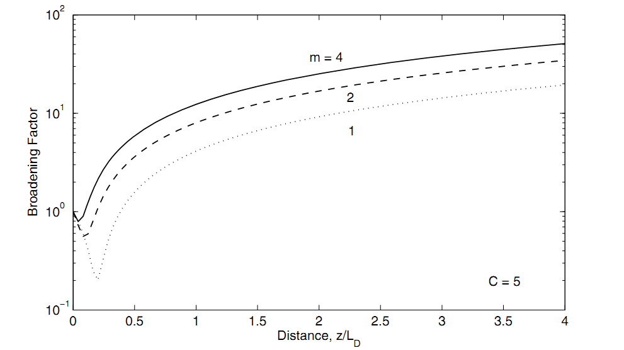
GVD-Induced Pulse Broadening
For complicated pulse shapes, the width can be more accurately described by the root-mean-square (RMS) width σ deﬁned as
For super-Gaussian pulses, the broadening factor is

Slide 16
Group-Velocity Dispersion
GVD effects in fiber
Dispersion-Induced Pulse Broadening
Third-Order Dispersion
Dispersion Management

Slide 17


Third-Order Dispersion
If the pulse wavelength is close to the zero-dispersion wavelength, the β₃ term provides the dominant contribution to the GVD effects. For ultrashort pulses, it is necessary to include the β₃ term even when β₂ is not small.
This equation can be solved by using the Fourier-transform technique
Dispersion length
The TOD effects play a signiﬁcant role only if T₀|β₂/β₃|≤ 1.

Slide 18
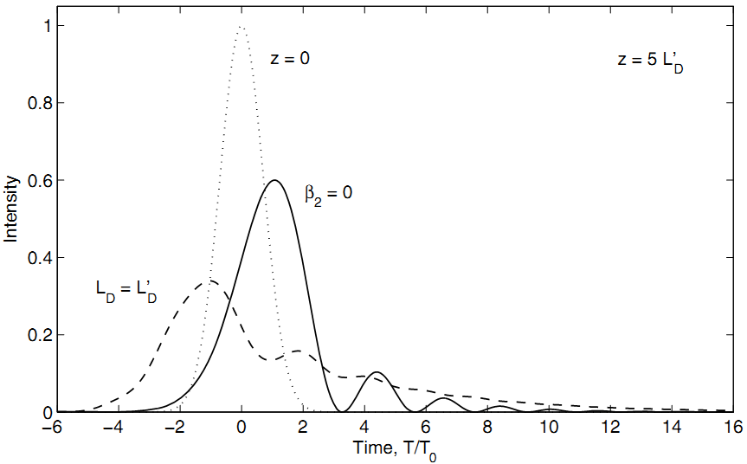

Third-Order Dispersion
TOD makes the becoming asymmetric with an oscillatory structure near one of its edges, depending on the sign of β₃; The existence of β₂ damps the oscillations.

Slide 19
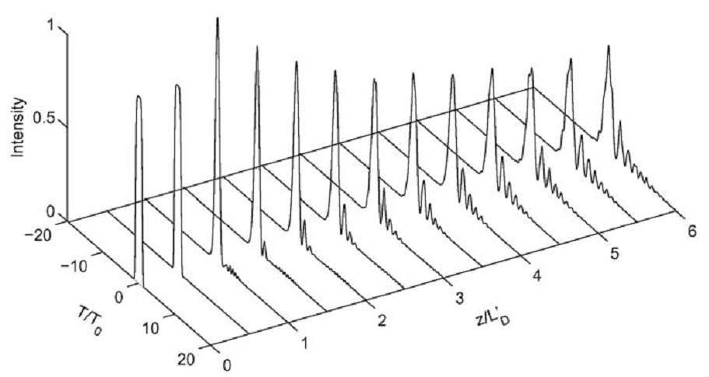

Third-Order Dispersion
Super-Gaussian Pulse Evolution

Slide 20
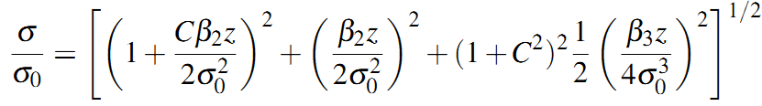
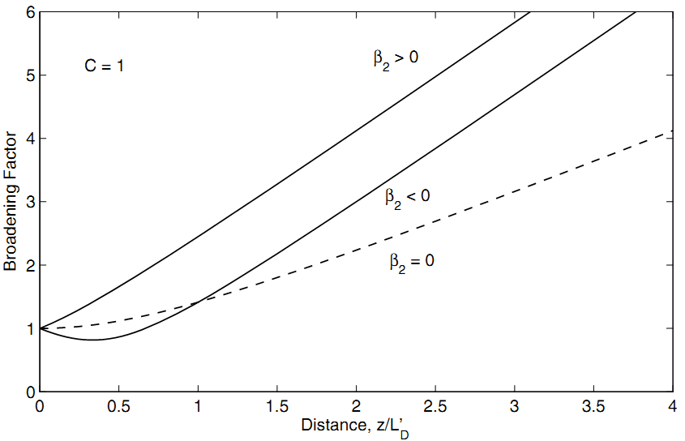


Third-Order Dispersion
Broadening Factor for the chirped Gaussian pulse

Slide 21
Group-Velocity Dispersion
GVD effects in fiber
Dispersion-Induced Pulse Broadening
Third-Order Dispersion
Dispersion Management

Slide 22



Dispersion Management
To include the effects of a ﬁnite source bandwidth
Assuming that the contribution of the β₃ term is negligible together
with C = 0 and V_{ω}>>1, the RMS pulse width σ is given by
Using the criterion that the broadened pulse should remain conﬁned to its own bit slot 4σ < T_{B} , the limiting bit rate must satisfy

Slide 23
GVD-Induced Limitations
To include the effects of a ﬁnite source bandwidth
Assuming that the contribution of the β₃ term is negligible together
with C = 0 and V_{ω}>>1, the RMS pulse width σ is given by
Using the criterion that the broadened pulse should remain conﬁned to its own bit slot 4σ < T_{B} , the limiting bit rate must satisfy

Slide 24




GVD-Induced Limitations
Using lasers operating in a single longitudinal mode: σ_{f} <100MHz;
Using dispersion-shifted ﬁbers: very small β₂ at the operating wavelength;
Assuming C = 0 .
Dispersion-induced broadening now depends on the initial width.
The limiting condition of bit-rate is

Slide 25
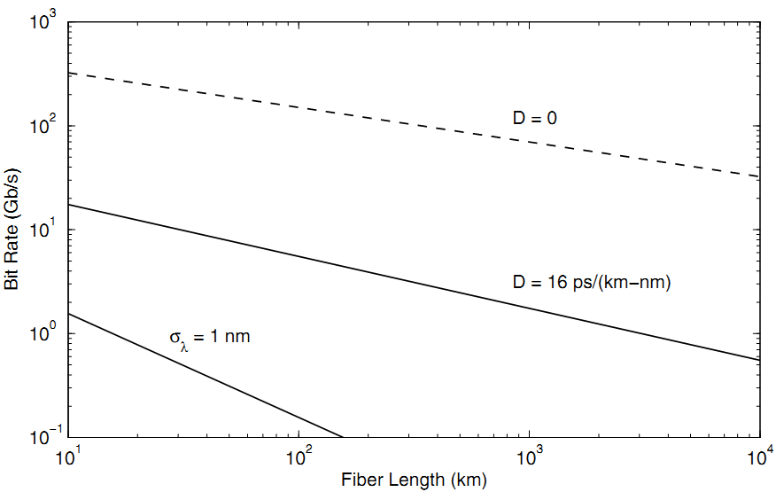
GVD-Induced Limitations

Slide 26




GVD-Induced Limitations
Operating exactly at the zero-dispersion wavelength, C = 0 and V_{ω}<<1
The limiting condition of bit-rate is
The bit-rate can be as large as 150Gb/s for L=100km and β₃ = 0.1ps³/km.

Slide 27

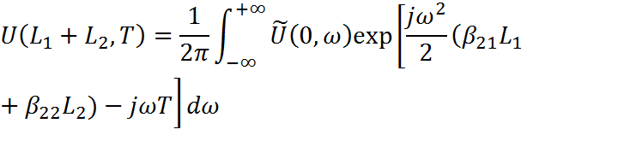

Dispersion Compensation
The basic dispersion-compensation technique takes advantage of the linear nature of the equation below
For a dispersion map consisting of two ﬁber segments
The condition for dispersion compensation can be written as
The pulse recovers its initial width after each map period even though pulse width can change signiﬁcantly within each period.

Slide 28



TOD Compensation
When the bit-rate of a single channel exceeds 100Gb/s, one may use ultrashort pulses (width ∼1ps) in each bit slot; the broad the pulse spectrum makes it difficult to compensate GVD over the entire bandwidth.
Generally, it is difficult to satisfy both conditions simultaneously over a wide wavelength range. However, for a 1ps pulse, it is sufficient to satisfy the conditions over a 4~5nm bandwidth.

Slide 29
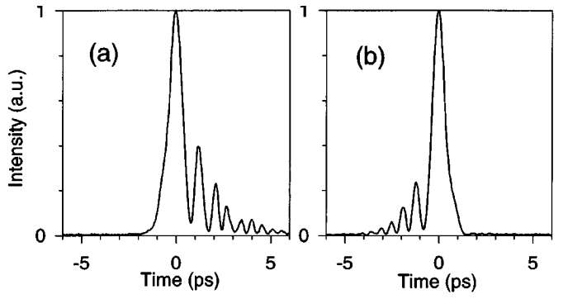
TOD Compensation
Experimentally observed shapes of a 0.5 ps input pulse at the output of a 2.5 km GVD-compensated ﬁber link. The value of β₃ was changed from 0.124 (left) to −0.076 ps³/km (right) using a liquid-crystal modulator.

Slide 30
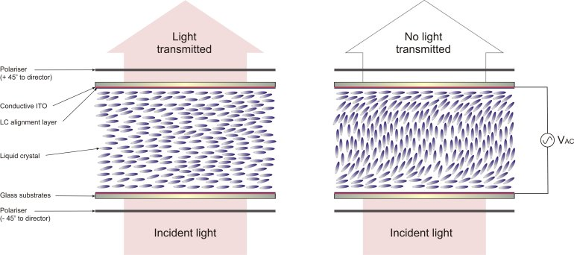
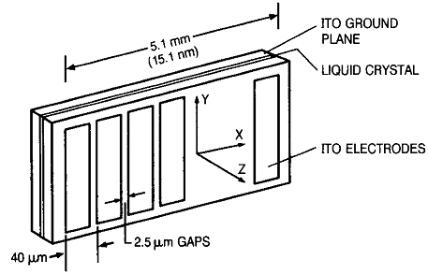
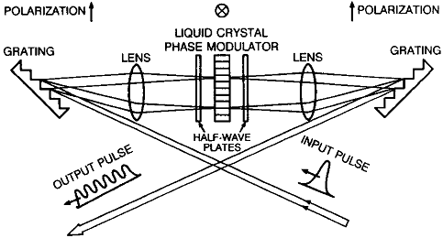
TOD Compensation
CMMPE Website, Univ. of Cambridge
A. Weiner, JQE, 28, 1079 (1992).

